Slide 1
Lesson 4
CSS Layout and Positioning

Slide 2
Agenda
Objective: Learn how to use CSS for layout and positioning of elements.
Topics Covered:
The box model: margins, borders, padding, and content
CSS positioning: static, relative, absolute, fixed
Using Flexbox for layout
Media Queries
Activity

Slide 3
The Box Model

Slide 4
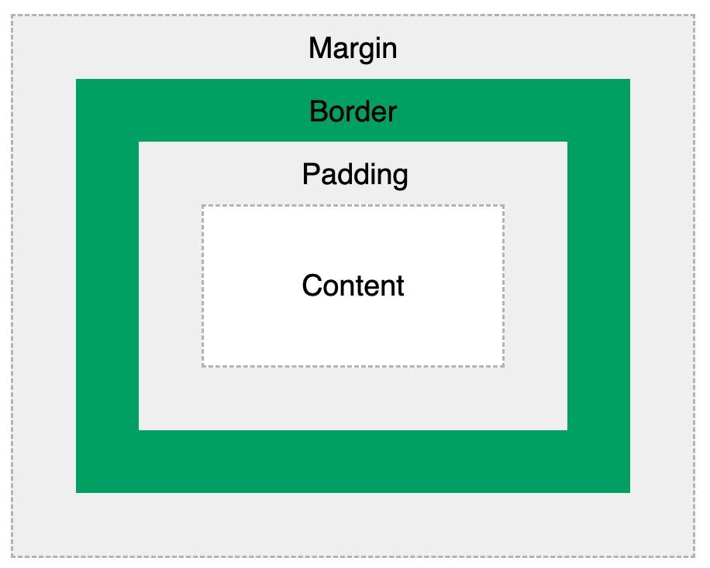
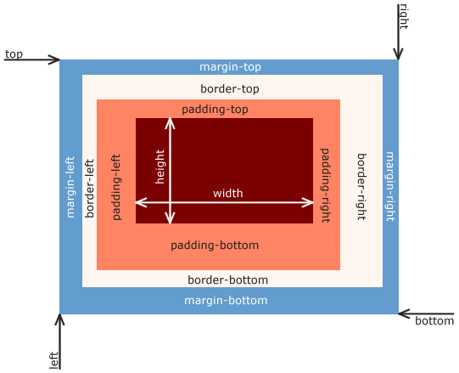
Box Model
a box that wraps around every HTML element

Slide 5
Box Model Parts
Content - The content of the box, where text and images appear
Padding - Clears an area around the content. The padding is transparent
Border - A border that goes around the padding and content
Margin - Clears an area outside the border. The margin is transparent
Allows us to add a border around elements
Define space between elements.

Slide 6
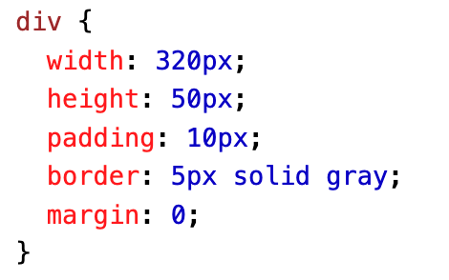
Width and Height of an Element
When you set the width and height properties of an element with CSS, you just set the width and height of the content area. To calculate the total width and height of an element, you must also include the padding and borders.
Total element width = width + left padding + right padding + left border + right border
Total element height = height + top padding + bottom padding + top border + bottom border
Total width and height of <div>?

Slide 7
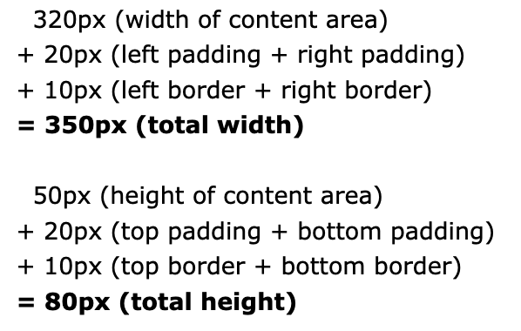
Solution

Slide 8
Quick Exercise
Copy HTML
<!DOCTYPE html>
<html>
<head>
<title>Box Model Exercise</title>
<link rel="stylesheet" type="text/css" href="style.css">
</head>
<body>
<div class="box">This is a box!</div>
</body>
</html>
Instructions (CSS)
Add padding of 20px.
Add a border of 5px solid black.
Add a margin of 15px.
Set the background color to lightblue.

Slide 9
Solution + Discussion Questions
.box {
padding: 20px;
border: 5px solid black;
margin: 15px;
background-color: lightblue;
}
How does changing the padding value affect the space inside the box?
What happens when you increase or decrease the border width?
How does adjusting the margin affect the space around the box?

Slide 10
Layout: the position Property

Slide 11
Static positioning
Default
Not affected by the top, bottom, left, right properties
Not positioned in any special way – just according to the flow of the page
position: static;
Example

Slide 12
Relative positioning
Positioned relative to its normal (would-be) position
Top, bottom, left, right: allow it to be adjusted away from normal position
position: relative;
Example

Slide 13
Fixed positioning
Positioned relative to viewport
Stays in the same place even if page is scrolled
Top, bottom, left, right are used to position it
Example (copy paste <p> a bunch of times)

Slide 14
Absolute positioning
Positioned relative to the nearest positioned ancestor (instead of relative to the viewport)
No positioned ancestors? It uses <body> and moves along with the page flow
Ancestor: an element that contains another specific element
E.g., in the example, the outer div is the ancestor of the inner div
Example
If the outer div did not have position: relative; the inner div would be positioned relative to the viewport, not the outer div.

Slide 15
Sticky positioning
Positioned based on user scroll position
Toggles between relative and fixed
Relative until a given position is met in the viewport
Then, fixed (sticking in place)
position: sticky;
Example

